Slide 1
And now
For something completely different

Slide 2
Optimizing WSUS
Common issues, where to find them and how to fix them.

Slide 3



Ben Whitmore
Scott McAllister
NotBenReader@PatchMyPC
Engineer @PatchMyPC
@byteben
@scotscottmca

Slide 4



How to love your WSUS server again
Why It’s Important to Love Your WSUS Server
How to Take Care of & Maintain Your WSUS Server
Community Tools to Make Your WSUS Servers Life Easier
Notes:
Session overview

Slide 5


Gauge the discontent in the room
Who has used WSUS before?
Has it made you grumpy?
Have you experienced issues, and were they easy to fix?
How regularly do you perform maintenance, if at all?
Who has nuked WSUS and started again?
How many WSUS servers do you have?
Notes:
Free coffee to person with most wsus servers

Slide 6

Why It’s Important to Love Your WSUS Server
Like anything you care about, it needs TLC
Car maintenance
Buying the wife gifts
Mowing the lawn
Keeping the fridge full of beer

Slide 7

What could happen if you don’t
Client scan performance
If you don’t carry out routine maintenance, you may well see your clients take hours, days, or even fail to complete their update scan, meaning your devices aren’t receiving updates
Lack of care on your upstream will affect downstream
Problems are multiplied like an uncontrolled rabbit population
May need to start from scratch
It’s entirely possible that your WSUS environment is so poorly maintained that the best course of action is to flatten it, reinstall and start from scratch
Notes:
https://learn.microsoft.com/en-us/troubleshoot/mem/configmgr/update-management/optimize-wsus-client-performance
https://learn.microsoft.com/en-us/troubleshoot/mem/configmgr/update-management/wsus-client-long-time-finish-update-scan
https://learn.microsoft.com/de-de/security-updates/windowsupdateservices/21669504

Slide 8

What could happen if you don’t
Disk Space (3rd party updates)
Even if you haven’t subscribed to a lots of products you can end up with WSUS consuming more space than you had originally planned for (UpdateServicesPackages / WSUSContent)
Database performance & Synchronization time
With the size of the WSUS catalogue continually growing, the DB does as well! And with increased database size and lack of maintenance comes poorer performance e.g. Sync Timeouts, increased SUP sync times and slowed query response times

Slide 9
Easy Wins

Slide 10
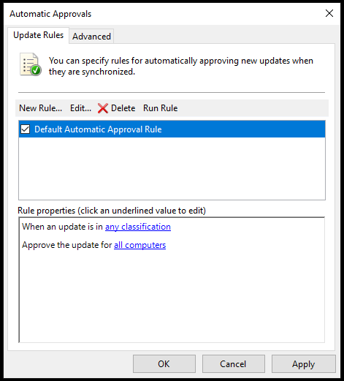
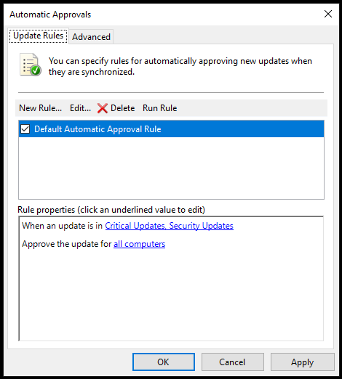
How to Take Care of & Maintain Your WSUS Server – Easy Wins
Configure automatic approvals sensibly (WSUS standalone)
Don’t select any classification, be specific
Notes:
In fact don’t do this is it’s a SUP

Slide 11
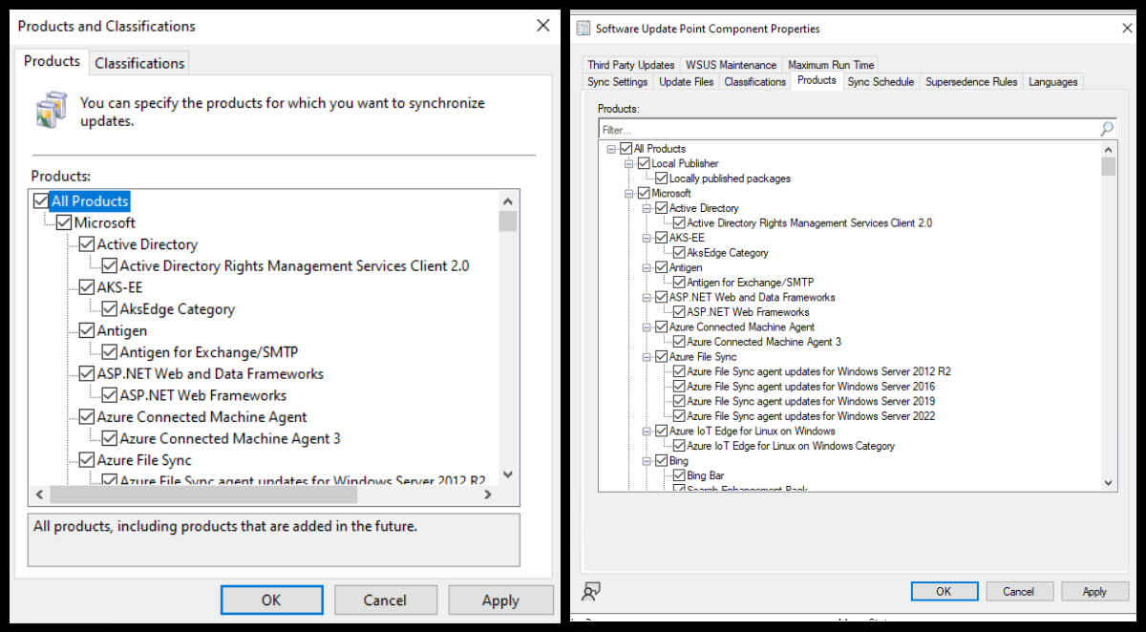
How to Take Care of & Maintain Your WSUS Server – Easy Wins
Using WSUS?
Check for Un-Needed Products that are Enabled
Using ConfigMgr?
Product selection should be done on SUP, or it will be overwritten on sync in WSUS
Slide Tip: Throw something at any attendee with XP selected still
Notes:
Product selection should be done is SUP or it will be overwritten on sync

Slide 12
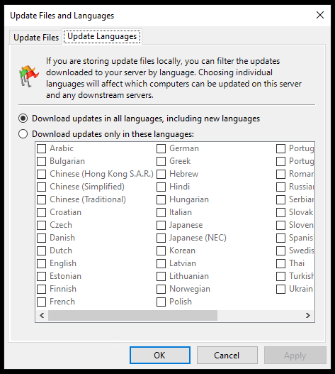
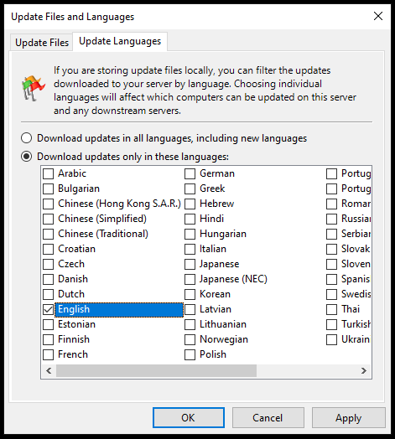
How to Take Care of & Maintain Your WSUS Server – Easy Wins
Don’t sync unnecessary languages
More languages = more storage = more for clients to evaluate = bad times.
Notes:
Do on SUP properties if not WSUS standalone

Slide 13
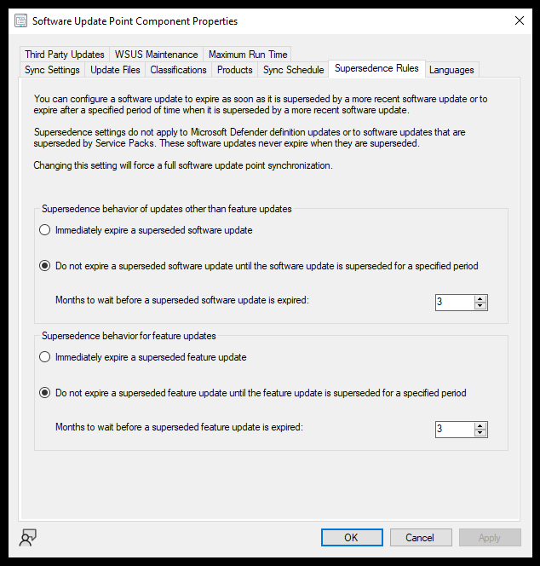
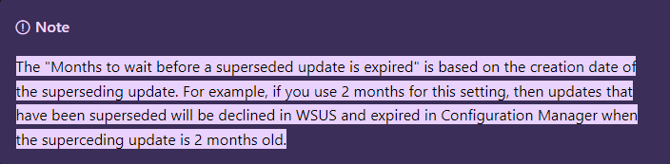
How to Take Care of & Maintain Your WSUS Server – Easy Wins
Using ConfigMgr?
Supersedence Rules
Configuration Manager builds a list of superseded updates from its DB, based on the supersedence configuration of your SUP.
The updates meeting supersedence configuration criteria are expired in the Configuration Manager console.
The updates are declined in WSUS for CAS, primary, and secondary sites.
Configuration Manager cleans up the database every seven days, removing unneeded updates from the console.
This cleanup won't remove expired updates from the Configuration Manager console if they're currently deployed.

Slide 14
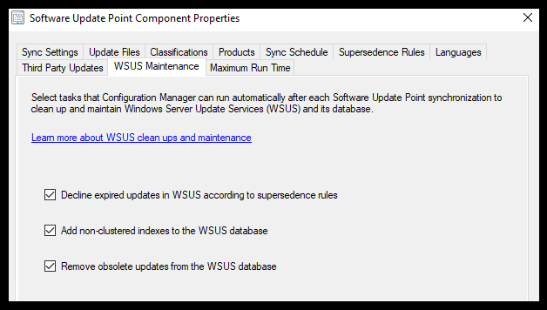
How to Take Care of & Maintain Your WSUS Server – Easy Wins
Using ConfigMgr?
Enable the Built-In WSUS Maintenance in ConfigMgr 1906 and Newer
Decline expired updates in WSUS according to supersedence rules
The more updates you have, the larger the catalogue sent to your clients. Declining updates in WSUS that are not required reduces the size of that catalogue, improving performance.
Add non-clustered indexes to the WSUS database
The most significant improvement to WSUS performance is adding these non-clustered indexes to tbLocalizedPropertyForRevision & tbRevisionSupersedesUpdate as it speeds up queries against these tables, allowing for quicker clean-up of unneeded updates.
Remove obsolete updates from the WSUS database
Updates that are no longer in the MS Catalogue, and not required, are considered obsolete. Removing obsolete updates clears them from your WSUS DB, again, improving performance
Notes:
Go to LAB
Show indexes Add note about the re-indexing maint plan?

Slide 15
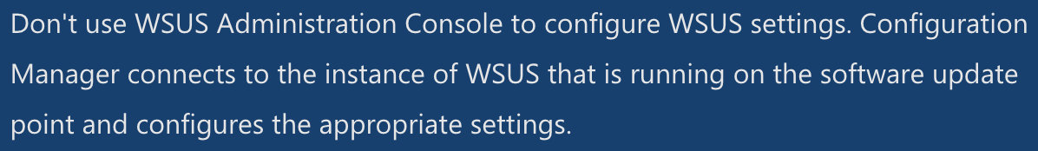
How to Take Care of & Maintain Your WSUS Server – Easy Wins
Decline updates you don’t need
We are told not to use the WSUS console if we are using ConfigMgr – ignore that advice ONLY to manually decline updates that may not be picked up in the SUP maintenance (more on that later)
Notes:
Any updates that are declined will no longer be offered to a client, either for evaluation or installation – including superceded updates
Dell applicability rules SUCK – WMI detection used..it WILL KILL YOUR CPU

Slide 16


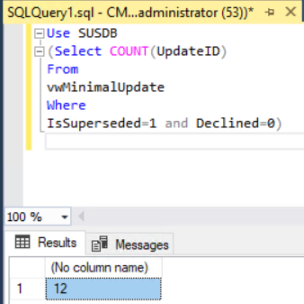
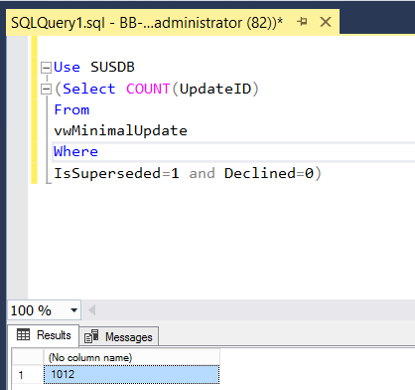
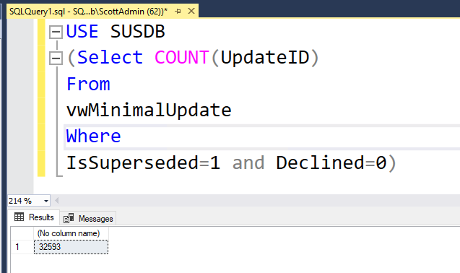



How to Take Care of & Maintain Your WSUS Server – Easy Wins
Microsoft says – we expect less than 1500 superseded updates to scan against
Select COUNT(UpdateID) From vwMinimalUpdate Where IsSuperseded=1 and Declined=0
LAB
TIME
GOOD BAD UGLY
Notes:
Use SUSDB
(Select COUNT(UpdateID)
From
vwMinimalUpdate
Where
IsSuperseded=1 and Declined=0)

Slide 17
How to Take Care of & Maintain Your WSUS Server – Easy Wins
Remove Obsolete Updates
Obsolete updates are unused updates and update revisions in the WSUS database. Generally speaking, an update is considered obsolete once it's no longer in the MS catalog and it isn't needed by other updates as a prerequisite or dependency.
Notes:
Wont work on a remote WID SUSDB – cleanup from the bottom up in the hierarchy is important!

Slide 18
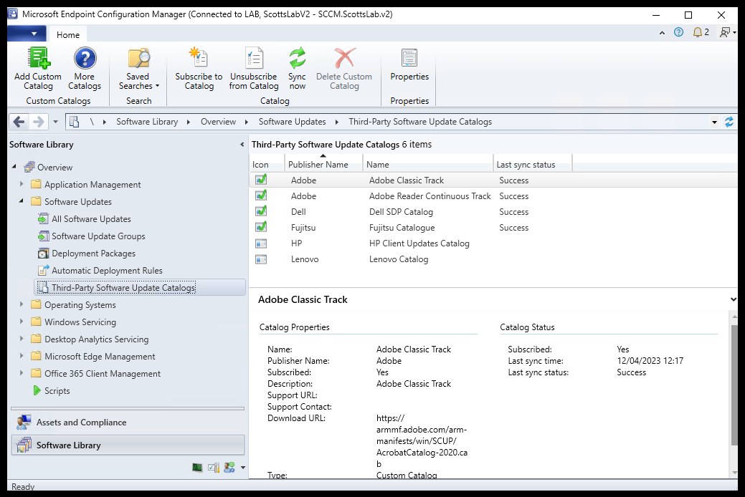
How to Take Care of & Maintain Your WSUS Server – Easy Wins
Using ConfigMgr?
Unsubscribe from unnecessary catalogues

Slide 19
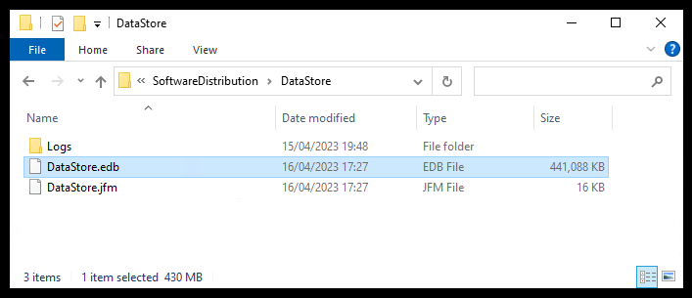

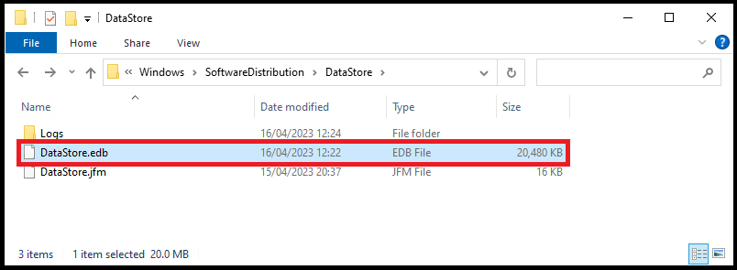
How to Take Care of & Maintain Your WSUS Server – Easy Wins
C:\windows\SoftwareDistribution\DataStore\datastore.edb
Example of client-side DataStore.edb file for full catalogue and no clean-up
Example of client-side DataStore.edb file for a maintained catalogue

Slide 20
Diving deeper

Slide 21
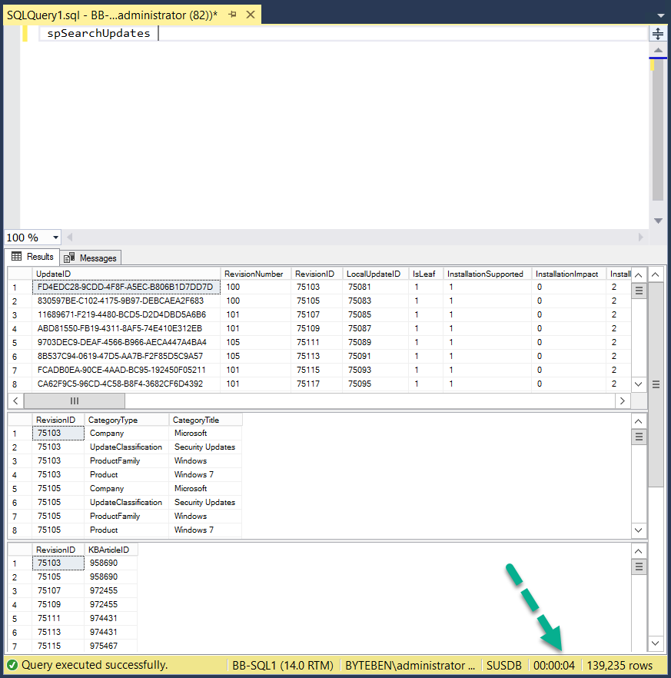
Client Scan Performance
To get a quick insight into potential problems in your environment, run
spSearchUpdates
LAB
TIME

Slide 22
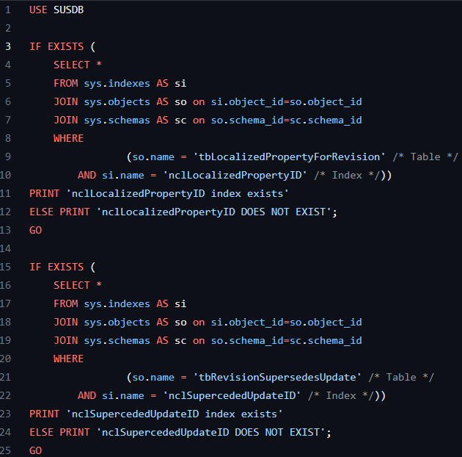

How to Take Care of & Maintain Your WSUS Server
Do indexes already exist?
Notes:
Go to LAB
Show indexes Add note about the re-indexing maint plan?
VSMUG/CheckIfIndexExists.sql at master · PatchMyPCTeam/VSMUG · GitHub

Slide 23
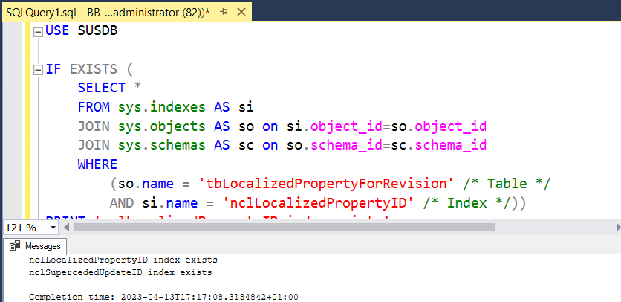
How to Take Care of & Maintain Your WSUS Server
LAB
TIME

Slide 24
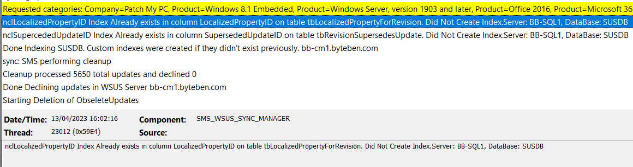
How to Take Care of & Maintain Your WSUS Server
Indexes exist – check is performed every sync
Notes:
Go to LAB
Show indexes Add note about the re-indexing maint plan?

Slide 25

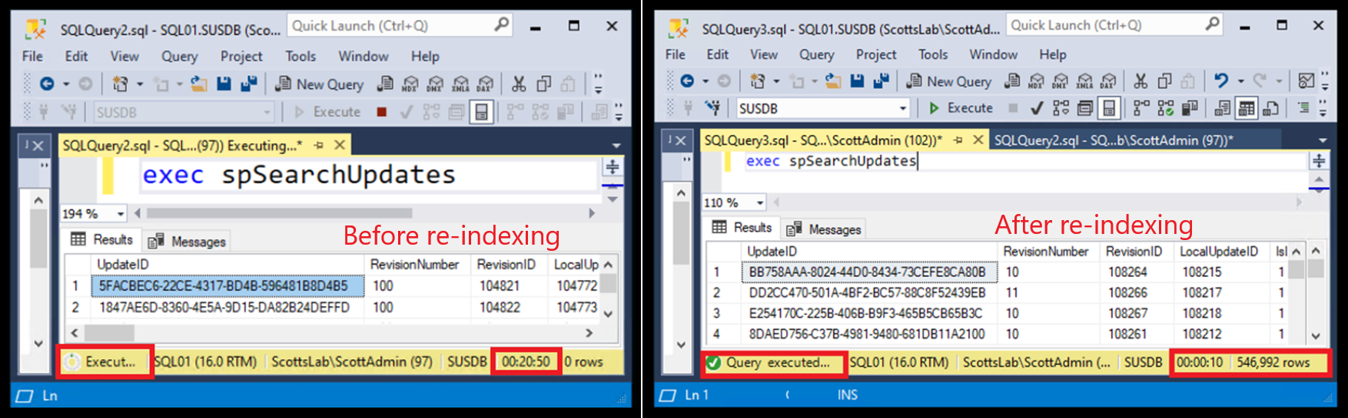
How to Take Care of & Maintain Your WSUS Server
Re-Index SQL
Microsoft provide a T-SQL script that
Identifies fragmented indexes and defrags them
Adds fill factors to improve insert performance
Updates potentially out-of-date table stats
Scheduled Task
Notes:
Reindex the Windows Server Update Services (WSUS) database - Configuration Manager | Microsoft Learn

Slide 26
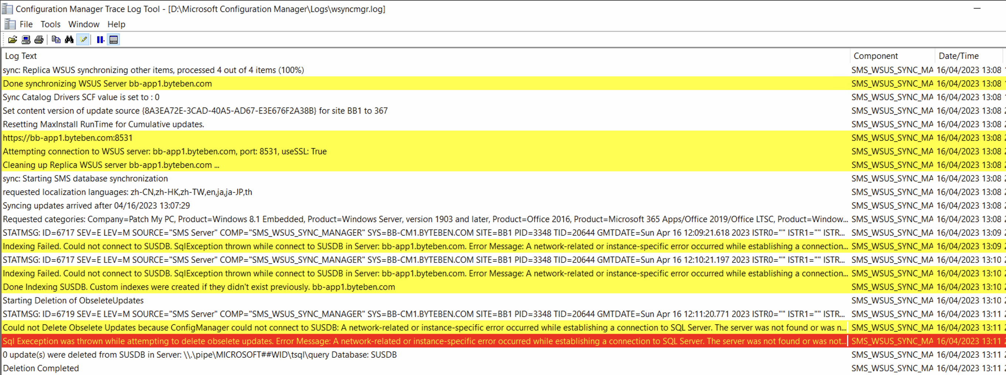

How to Take Care of & Maintain Your WSUS Server
SUP maintenance on a remote SUP with WID?

Slide 27

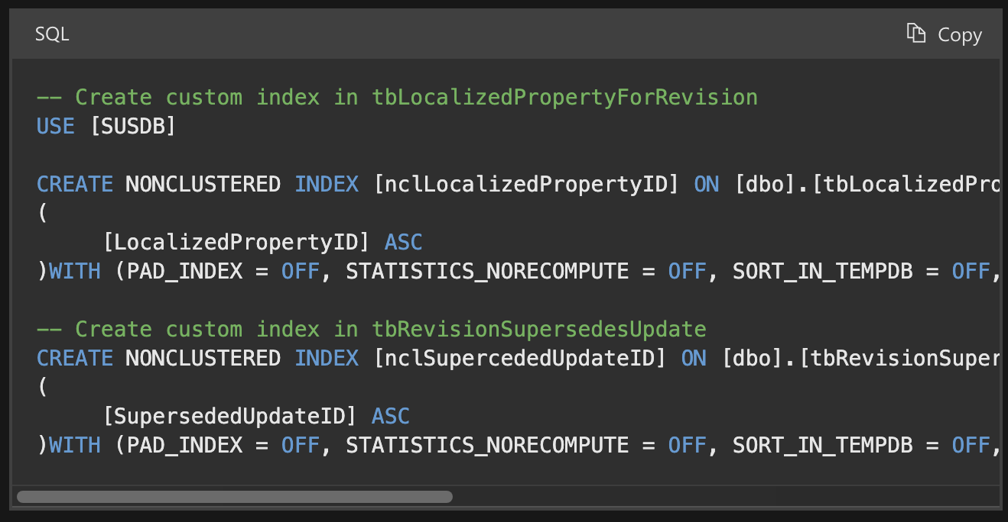
How to Take Care of & Maintain Your WSUS Server
Create Indexes manually for WID
Notes:
https://learn.microsoft.com/en-us/troubleshoot/mem/configmgr/update-management/wsus-maintenance-guide

Slide 28
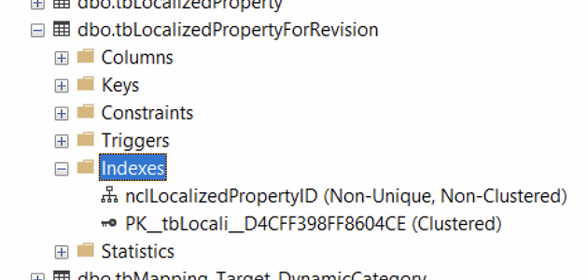
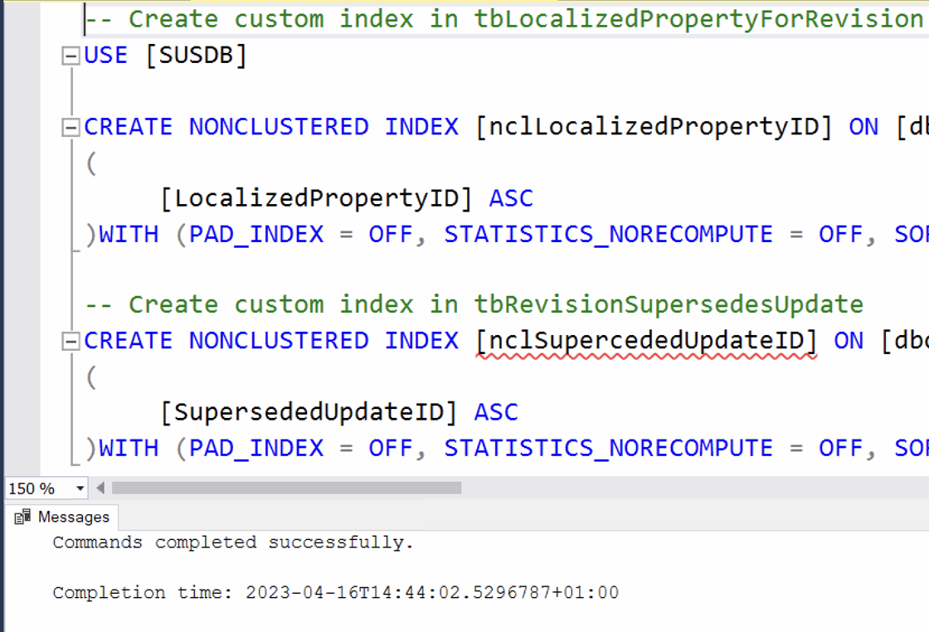

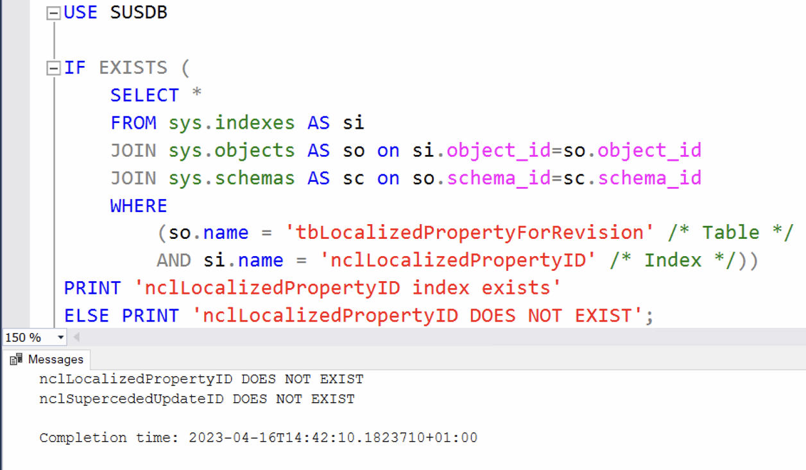


How to Take Care of & Maintain Your WSUS Server
Create Indexes manually for WID
Notes:
Windows Server Update Services (WSUS) maintenance guide for Configuration Manager - Configuration Manager | Microsoft Learn

Slide 29
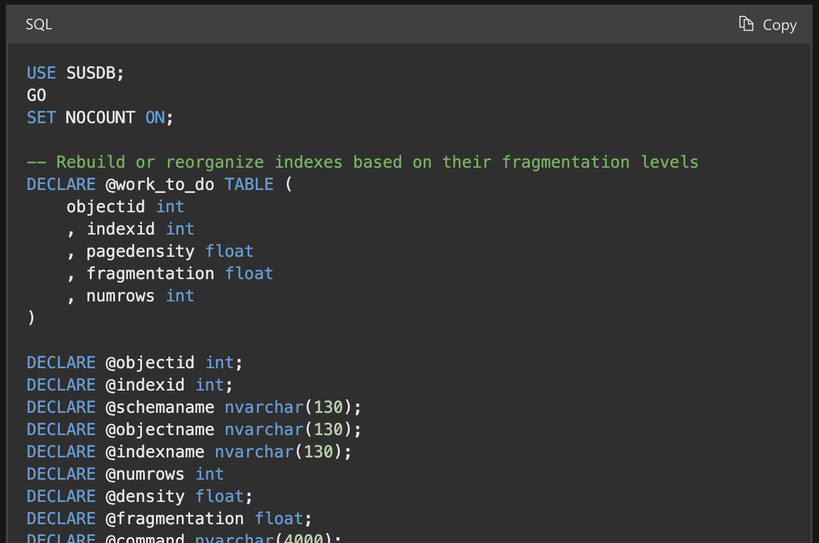
How to Take Care of & Maintain Your WSUS Server
Re-Index WID
Notes:
https://learn.microsoft.com/en-us/troubleshoot/mem/configmgr/update-management/reindex-the-wsus-database

Slide 30
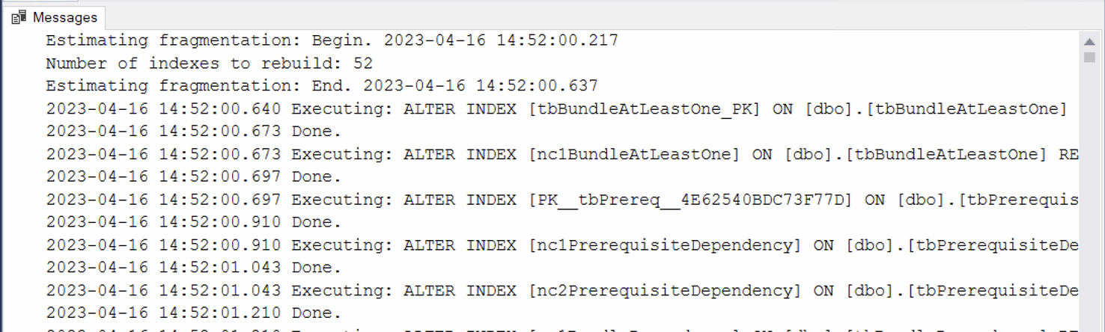

How to Take Care of & Maintain Your WSUS Server
Re-Index WID
Scheduled Task
"C:\Program Files\Microsoft SQL Server\110\Tools\Binn\SQLCMD.exe" -S \\.\pipe\Microsoft##WID\tsql\query -i C:\WSUS\ReIndex.sql -o C:\WSUS\ReIndexSUSDB.txt
Notes:
Reindex the Windows Server Update Services (WSUS) database - Configuration Manager | Microsoft Learn

Slide 31
Diving deeper – What else could go wrong?

Slide 32
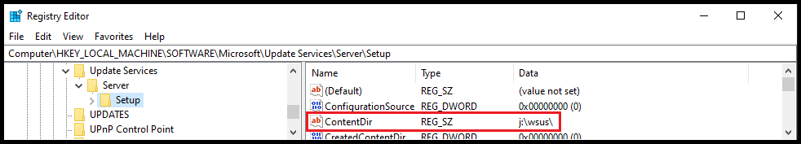
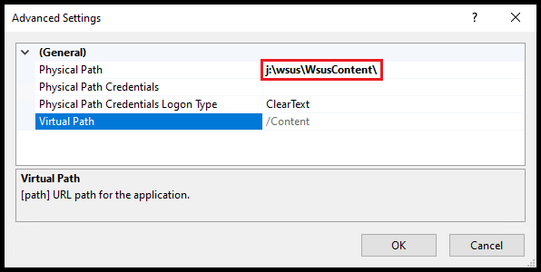
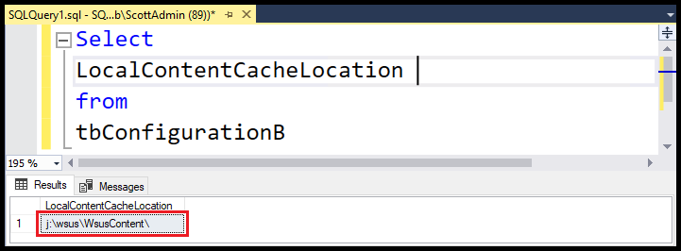
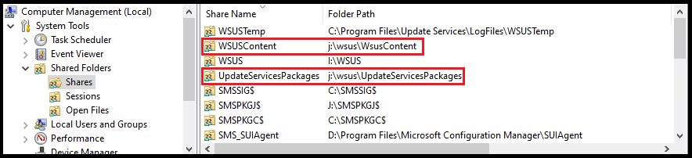
How to Take Care of & Maintain Your WSUS Server
All WSUSContent paths should match & exist!
If you have configured WSUS Correctly, All your content paths should match.
This ensures everything, no matter whether it gets the path from SQL, IIS or the Registry, gets content from the same location.

Slide 33
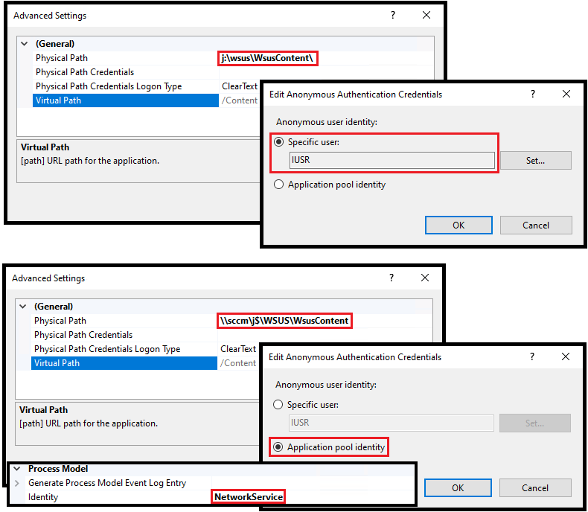
How to Take Care of & Maintain Your WSUS Server
IIS WSUS Content Authentication & App Pool Identity
IUSR is a local account, created by default when installing IIS. It cannot authenticate to any remote UNC share.
If your WSUS Content is configured to use a UNC path, using the Application pool identity is recommended as this is NetworkService by default.

Slide 34
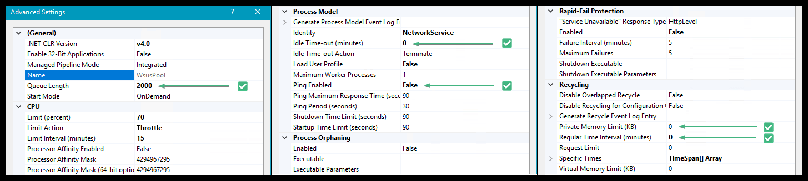
How to Take Care of & Maintain Your WSUS Server
Queue Length
A maximum number of requests can be handled by IIS, determined by the max number of threads and concurrent connections. Once exceeded, IIS will queue requests, and once that queue is full IIS will serve a 503 “Service Unavailable”
Doubling the default value to 2000 allows for a longer queue before the service becomes unavailable

Slide 35
How to Take Care of & Maintain Your WSUS Server
Idle Time-out
Defaulting to 20 minutes, IIS will drop the worker process after 20 minutes of activity to free it up for something else
Lowering this to 0 allows it to drop those workers immediately

Slide 36
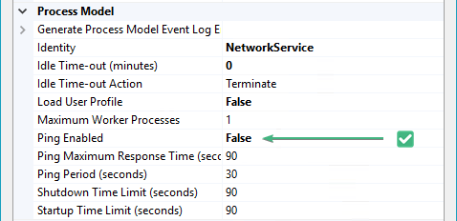
How to Take Care of & Maintain Your WSUS Server
App Pool Heartbeat (Ping)
Defaulting to Enabled, App Pools use Ping as a heartbeat. It'll be recycled if the app pool gets overwhelmed and doesn’t respond to a ping.
Whenever the WSUS App Pool recycles, it rebuilds its cache, which can be memory intensive
To avoid the app pool being recycled, the recommendation is to disable Ping

Slide 37
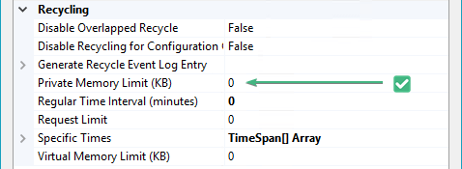
How to Take Care of & Maintain Your WSUS Server
App Pool Private Memory Limit
Set to 1.8GB(1,843,200KB) by default, the WSUS App Pool will recycle if its Private Memory Limit is reached.
Whenever the WSUS App Pool recycles, it rebuilds its cache, which can be memory intensive
To avoid this, we want to increase that memory limit to 0 (Unlimited)

Slide 38
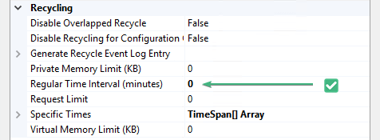
How to Take Care of & Maintain Your WSUS Server
App Pool Regular Time Interval
By default, the WSUS App Pool is configured to recycle every 29 hours.
Whenever the WSUS App Pool recycles, it rebuilds its cache, which can be memory intensive
To avoid this, reduce the Time Interval to 0 so it never recycles.
Notes:
IIS implements an automatic recycling of the application pool every 29 hours, Ping, and Idle Time-outs, all which should be disabled.

Slide 39
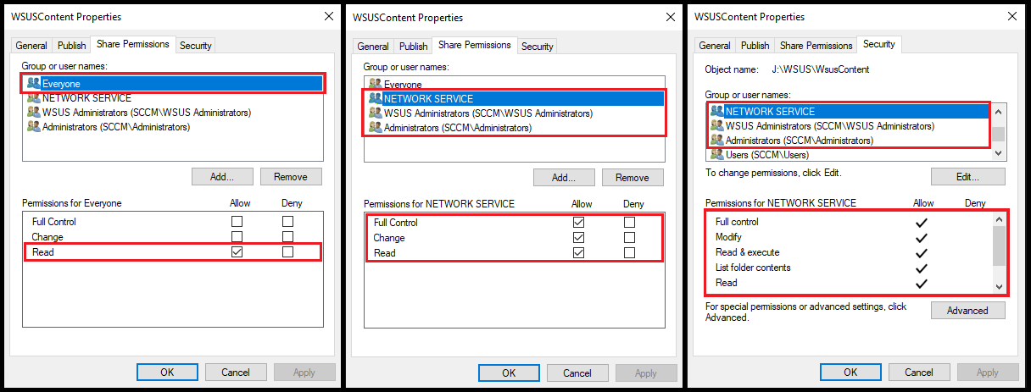
How to Take Care of & Maintain Your WSUS Server
Share permissions

Slide 40
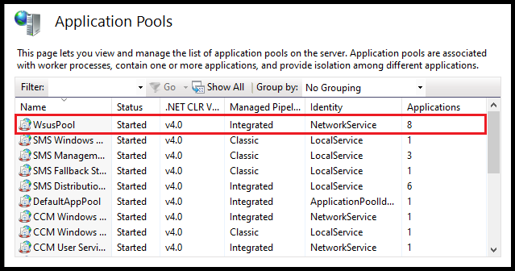
How to Take Care of & Maintain Your WSUS Server – Saving the easiest for last
WSUS App Pool state

Slide 41
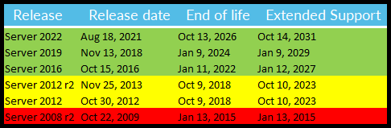
How to Take Care of & Maintain Your WSUS Server – Saving the easiest for last
Is your WSUS version supported?

Slide 42

Community Tools to Make Your WSUS Servers Life Easier / Do you want to do this manually?
Community blogs & tools
SCCM/MECM WSUS Maintenance Guide – Scott Fairchild
Rebuilding WSUS – Mariano Grande (Microsoft)
The Simple Guide to WSUS Maintenance – Patch My PC
Fixing WSUS – The best defense is a good offense – Johan Arwidmark
Clean up WSUS UpdateServicesPackages – Patch My PC
MEM Patching Optimizer – Patch My PC
SQL Server Maintenance Solution – Ola Hallengren

Slide 43


Gifs to use somewhere?
Live Long and Prosper
Are users giving you shit?

